Slide 1
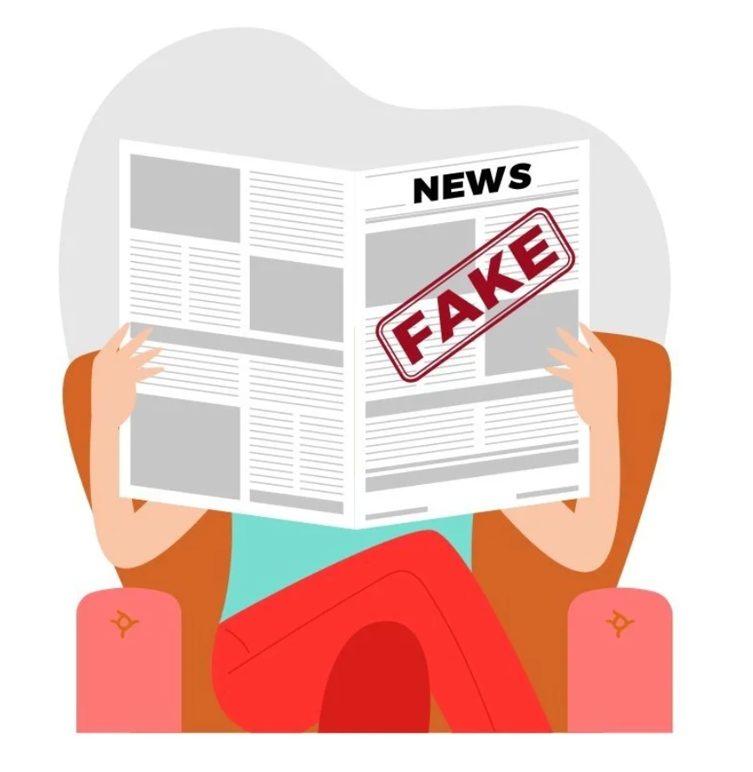
Fake News Detection
Group 9: Minju Bae, James Bruggink, Juncheng Long, Eric Sun, Leo Xiong

Slide 2
Goal
Rich and unique topic to do machine learning
We used KAGGLE to find our dataset
Dataset contains news articles labeled as real and fake along with other variables
Notes:
Our goal was to find a topic that would be rich and unique to do machine learning on. After some time searching through KAGGLE, deliberation and voting, we decided to choose fake news detection. Our dataset contains information about various news articles labeled as REAL and FAKE, along with other variables we used to train our model in order to help it determine Real or fake news using train_test_split

Slide 3
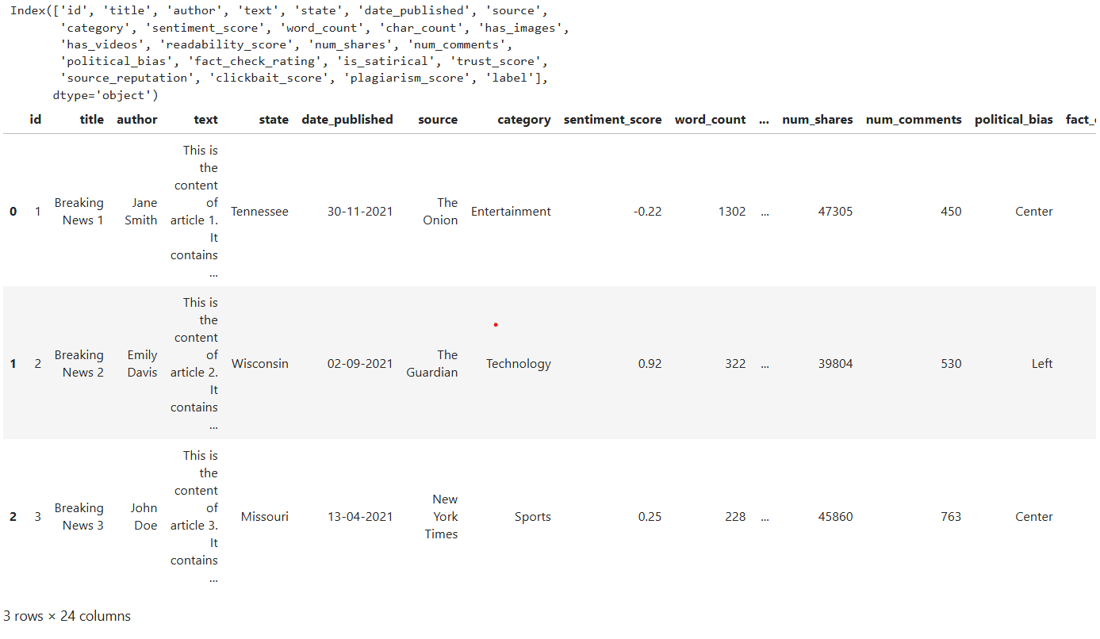
Dataset Example
Notes:
Here is a few examples of what our dataset looked like when we used pandas to read the file. It has information such as the state where it was published, the date and what media companies have published them

Slide 4
Important Variables
Sentiment_score
  Attitude toward article
Word_count
  Number of word in article
Readability_score
  measures how easy or hard a text is to read
Num_shares
  Number of shares of article
Num_comments
  Number of comments on the article
Trust_score
  Credibility of article
Source_reputation
  Credibility based on publisher
Notes:
These are the variables we hand-chose for our project to do our modeling on. We had feature selection originally choosing what variables to use, but we ended up with with low accuracy and precision using what feature selection told us to do leading to high counts of false positives and false negatives. Hand-picking our variables gave us more accurate results in determining if machine learning can detect fake news.

Slide 5
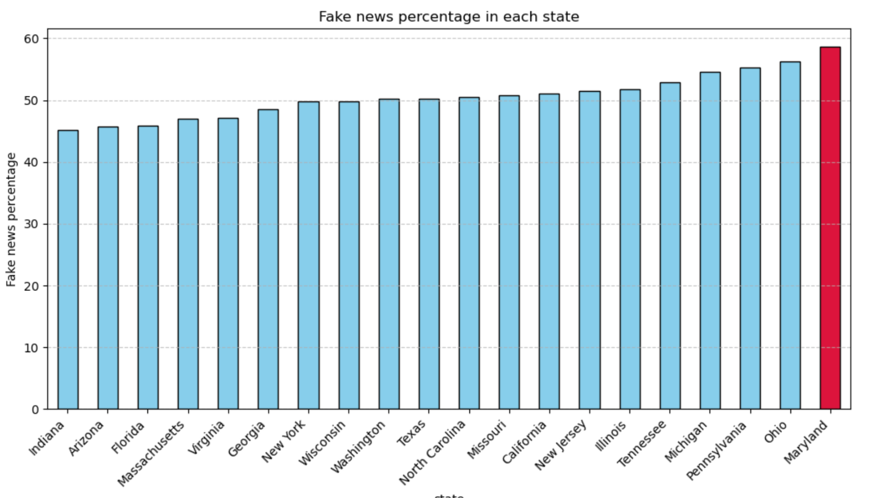
Q1. Which state might be populated with the most fake news ?
Notes:
Hi, My name is Eric. On this slide, the question we are exploring is:"Which state might be populated with the most fake news?"
The bar graph shows the fake news percentage in each state. As we can see, Maryland stands out clearly, with the highest percentage of fake news among all the states listed. It is highlighted in red for emphasis.
You might wonder: why are we looking at percentage instead of the absolute number of fake news articles?
Using percentage allows us to normalize across states of different population sizes. Some states, like California or Texas, naturally have more people and can create more content overall. If we only compared the count of fake news articles, larger states would dominate simply due to their size, not because fake news is necessarily more prevalent there. As a result, we do some variable preprocessing to get the right format.

Slide 6
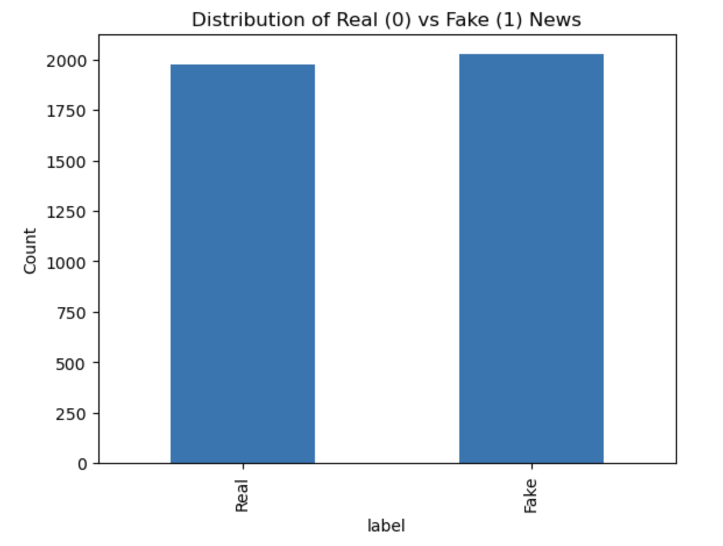
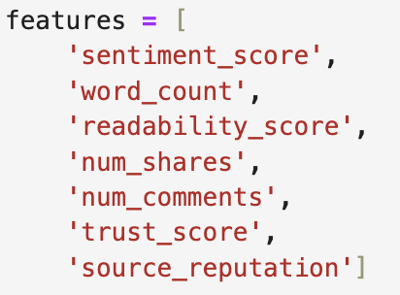
Q2: Which model performed the best in detecting fake news and how did it work?
Step 1: Check Dataset
Step 2: Feature Selection

Slide 7
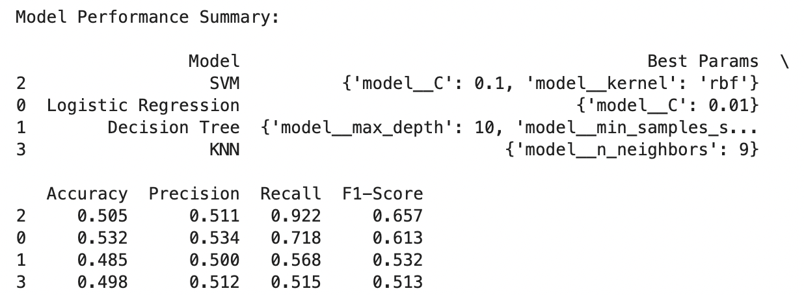
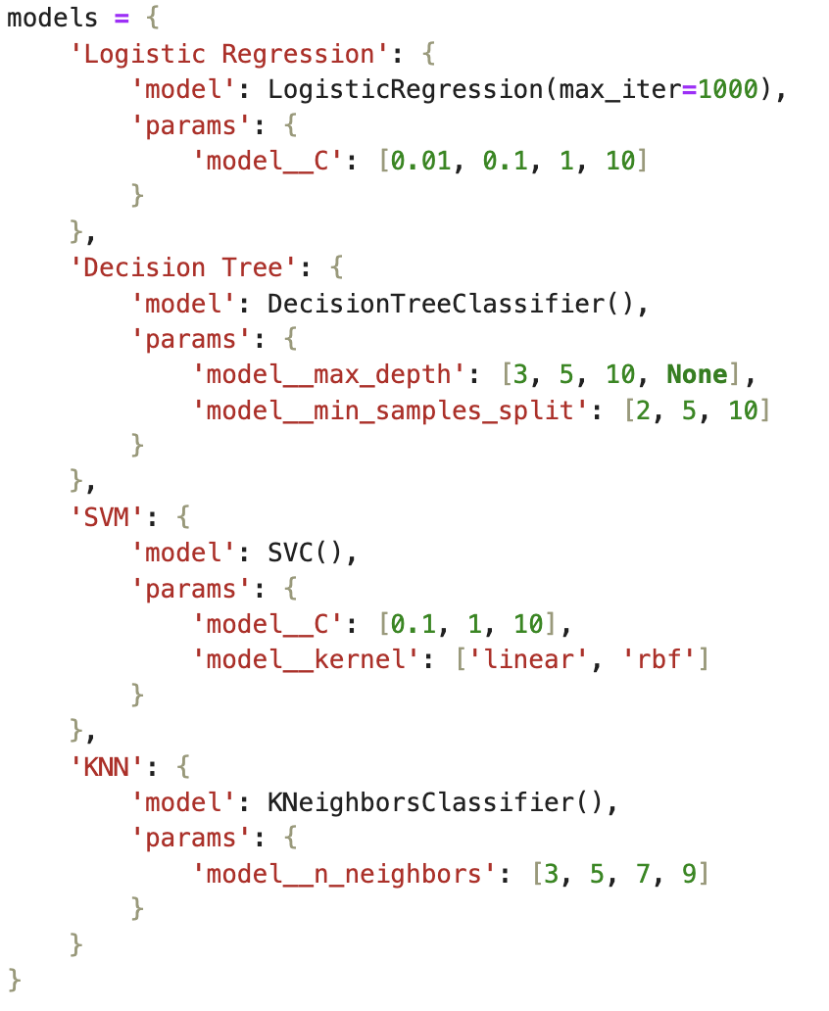
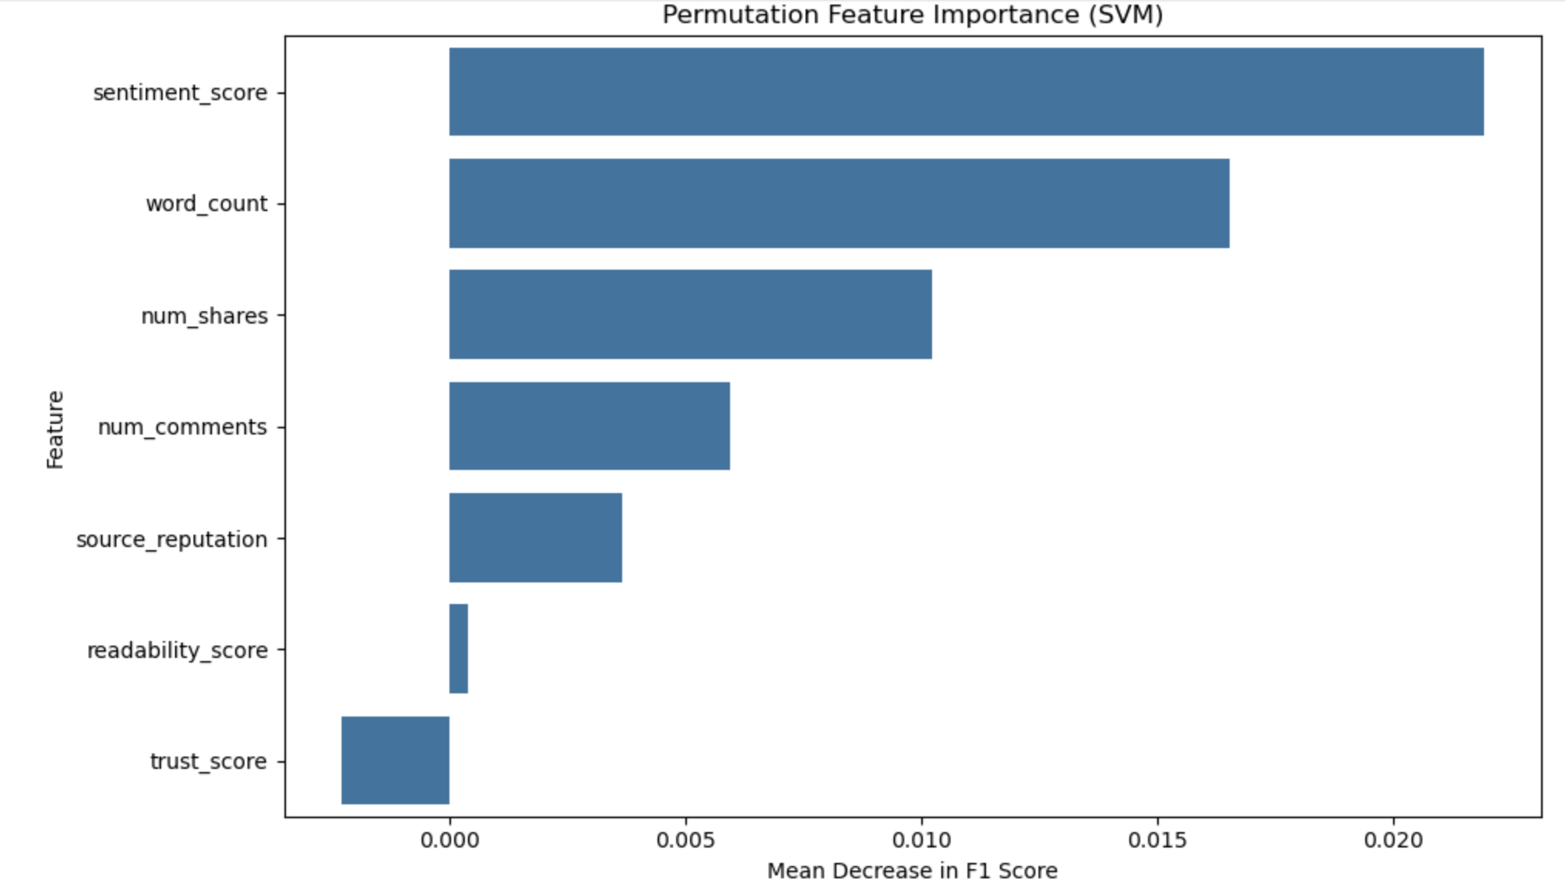
Final: Outcomes from Validation Set
Step 3: Data Split & Compare Models & Feature Permutation

Slide 8
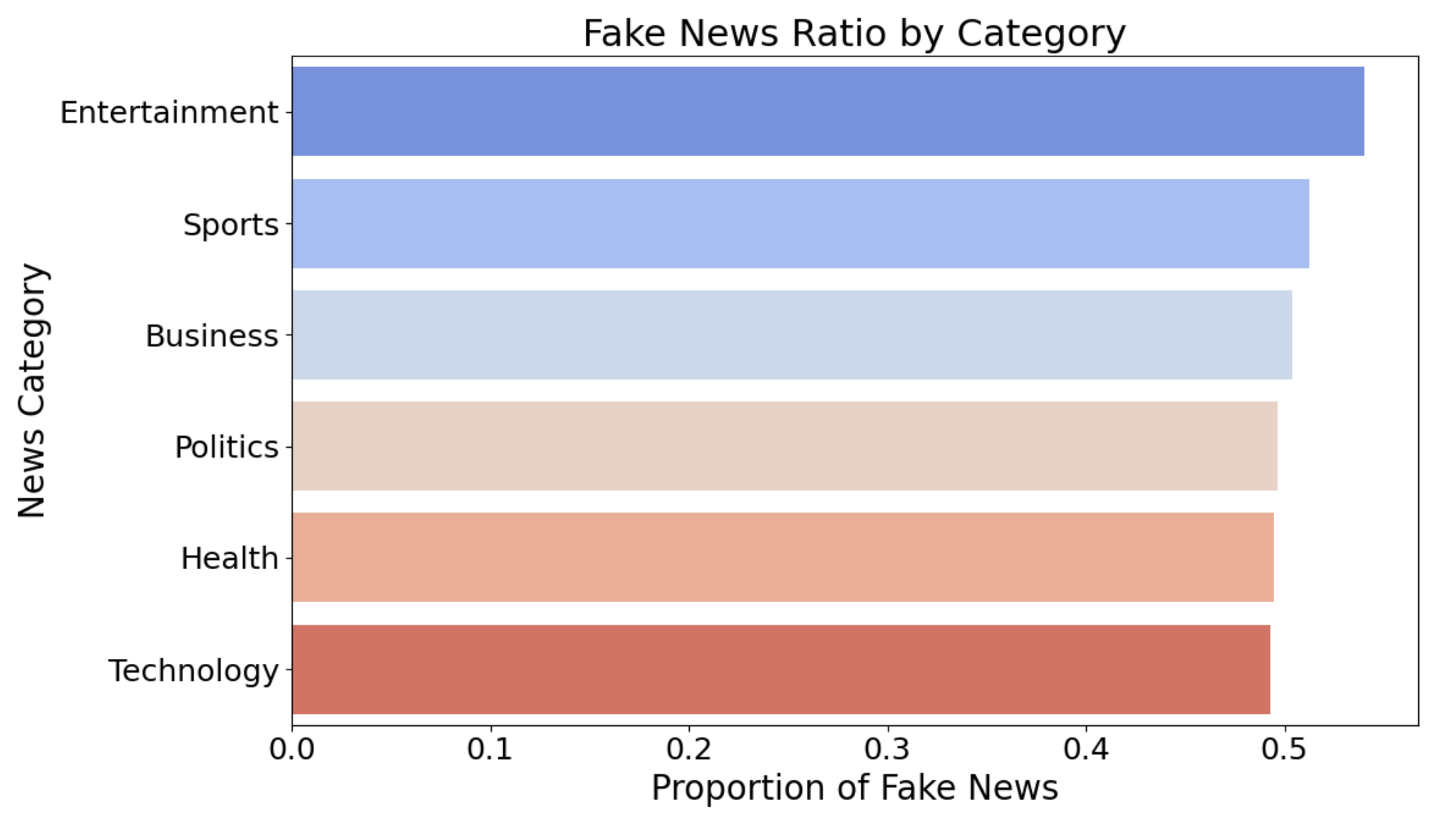
Q3. Which topics are more likely to be fake or real in the data?
Notes:
We wanted to answer the question: "Which news topics are more likely to be fake?"
To do this, we grouped the data by category, calculated the proportion of fake news in each one, and visualized the results.
As you can see in the chart, categories like Entertainment, Sports, and Business show a slightly higher proportion of fake news, while Technology and Health are a bit lower. However, the differences across categories are not very large, suggesting that fake news is fairly spread out and not limited to just one or two topics.

Slide 9
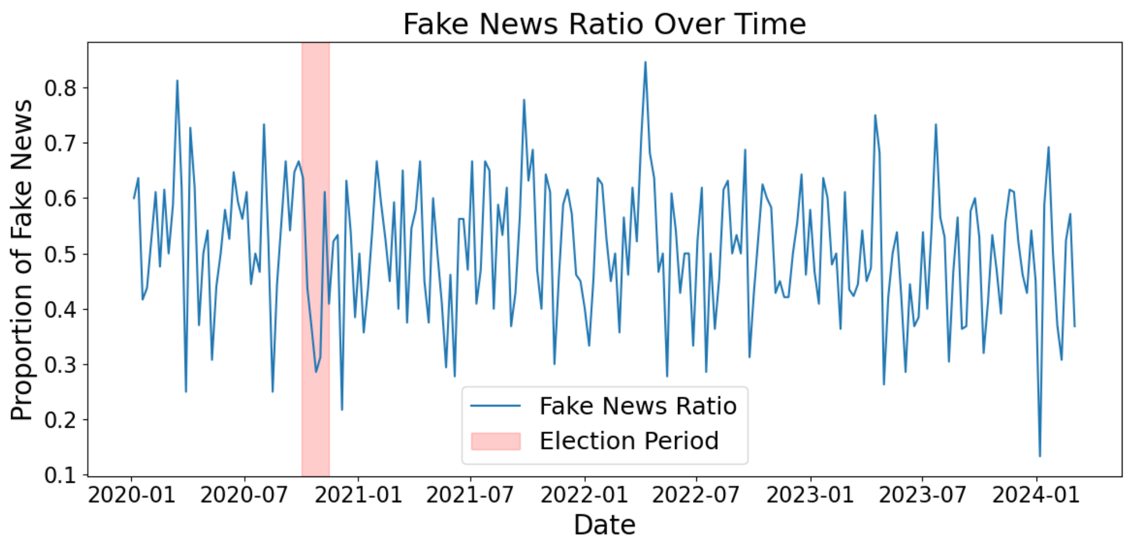
Q4. Does fake news increase during political events?
FNR = 0.42
FNR = 0.51
Notes:
We aimed to explore the question: Does fake news increase during political events?
To investigate this, we focused on the 2020 US presidential election. We defined the election period as the time from October 1 to November 15, which includes the weeks leading up to and following the election day on November 3.
We processed the article dates, calculated the weekly proportion of fake news, and visualized the trend over time.
In the chart, the red shaded area shows the election period. Interestingly, the average fake news ratio during that time was 0.42, which is actually lower than the average outside of that period, which was 0.51.
This suggests that fake news did not significantly increase during the election period in this dataset.

Slide 10
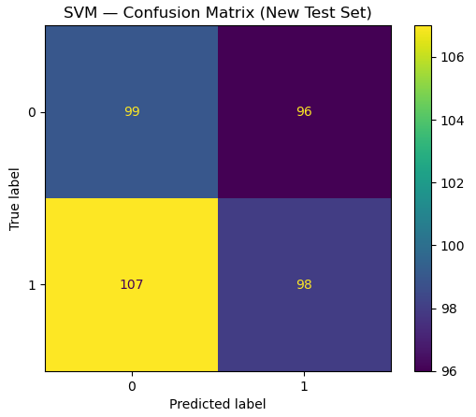
Conclusion + Next Steps
Key Takeaways
High recall, but low precision
Many false positives and negatives
Limitations
Differences between real/fake news very minimal
Precision sufferers from labeling real news as fake news
Notes:
In this project, we developed machine learning models to classify news articles as real or fake. While our models, particularly the SVM, achieved high recall, they suffered from low precision often predicting articles as fake when they were real (bottom left), and real when they were fake (top right). The confusion matrix highlights this imbalance, with a significant number of false positives, top right, and false negatives, bottom left. The test set also does not have as high an f1-score and recall as the validation set which suggests the model is overfitting to patterns that aren’t generalizing well to new data. One major limitation is the dataset itself, which is not informative enough to achieve high precision and capture the subtle differences of real versus fake news. This result was not a surprise as the differences between real and fake news are often difficult to differentiate even to a casual reader; this is because fake news is often written and presented as if it were real news, which is likely part of our precision issue as we did not do any text analysis of the articles. As a next step, we plan to improve model generalization by reducing overfitting, potentially through techniques like cross-validation, feature selection, or trying a more detailed and informative dataset as well as trying some deep learning methods to detect fake news by analyzing the articles’ text.

